Slide 1
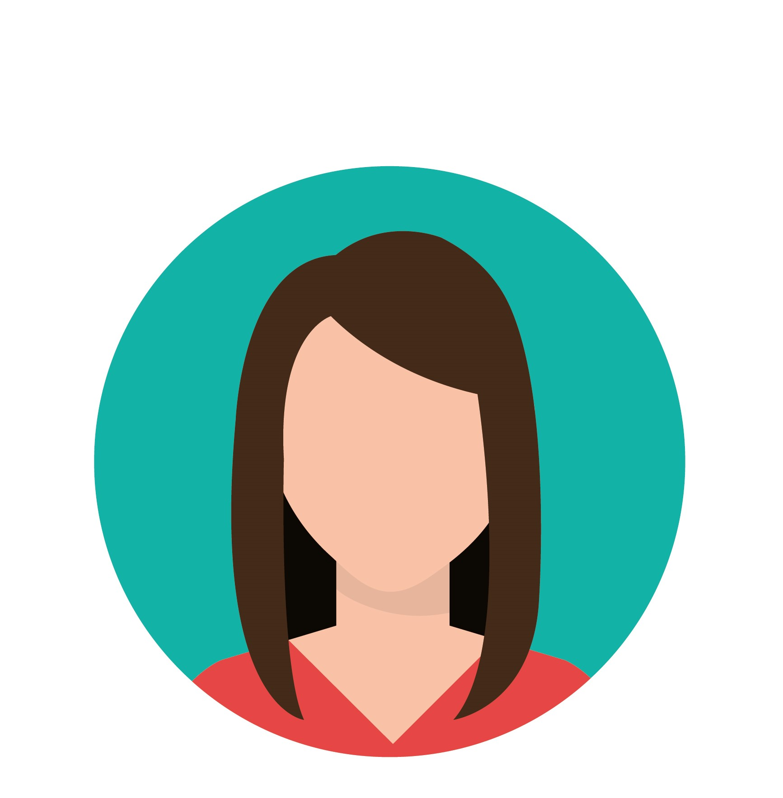
“Words are the windows to my soul, and reading is the key that unlocks them. As a content writer, I use that key to create meaningful connections with my readers.”
Goals
To stay curious, do researches and gain inspirations for her own writing.
To save as much time as possible while researching to meet the deadlines.
Frustrations
Not having a separate section for highlights in an ebook so that they can be accessed altogether at once
Lots of distractions and constant urge to switch apps while reading on phone.
Add image that represents this persona
Sarah
Sarah works from home for a digital marketing company.She typically works from 9am to 5pm, but is flexible with her schedule when necessary.Sarah often spends time researching her topics before starting to write, and she creates outlines to help guide her writing process.She is diligent about meeting her deadlines and takes pride in submitting work that is error-free and engaging.
Age:
Education:
Hometown:
Family:
Occupation:
22
Bachelor’s Degree in
English
Delhi
Lives with her mother
Content Writer

Slide 2
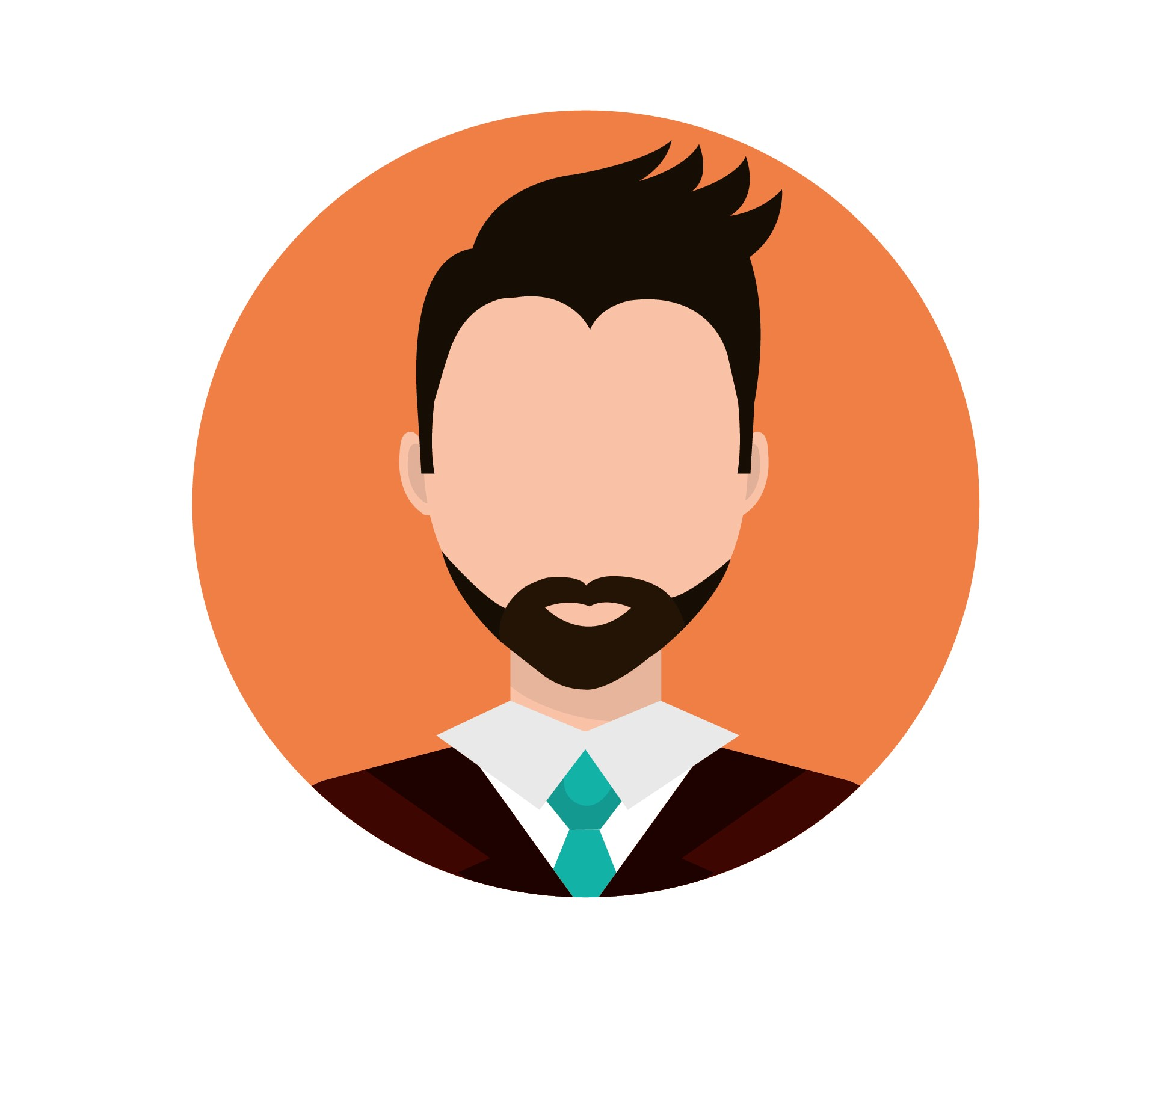
“The more I learn and discover, the more I realize how much I have yet to learn. But that only fuels my curiosity and drives me to keep pushing the boundaries of knowledge.”
Add image that represents this persona
Goals
Advancing his research
Stay up to date and Engaging with the students
Have a good work life balance.
Frustrations
Complexity of some reading apps and inability to adjust fonts as per own choice.
Lack of auto save options.
Ritik
Age:
Education:
Hometown:
Family:
Occupation:
36
PhD in Sociology
Kolkata
Lives with a partner
Professor of Sociology.
Ritik grew up in a small town in the midwest and was always passionate about learning and reading. He pursued his undergraduate degree in sociology at a state university and went on to earn his PhD from a top-ranked research institution. He also likes reading as a hobby but is not really tech savvy so prefers easy to use apps for reading.Ritik wants to work efficiently but also maintain a good work life balance.

